Slide 1
Ward Conference Gospel Doctrine Lesson
Obedience to the commandments develops respect in the family and ward
http://2understandamormon.com/k11ward/obedience.pptx

Slide 2
What are the things that a faithful Latter Day Saint should have/accomplish/be working on/be obeying?
Faith, Repentance, Baptism, Confirmation, Ordination(men), Endowment, Missions, Temple Marriage.
Prayer(personal, couple, family), scripture study(personal & family), monthly fasting, paying tithing, magnifying their callings(includes callings that we are not set apart for… spouse, father, mother).
Church attendance, meaningful participation in the Sacrament, obedience to the Word of Wisdom, Obedience to the Law of Chastity.
Home/visiting teaching, family history, temple attendance.

Slide 3
What are the five basic laws of the Church?
Law of Obedience
Law of Sacrifice
Law of the Gospel
Law of Chastity
Law of Consecration

Slide 4
A House of God
Roof
Law of
Consecration
Law of
Chastity
Walls
What happens to a building if the footings are weak?
Law of the Gospel
Floor
Law of Sacrifice
Foundation
Law of Obedience
Footings

Slide 5
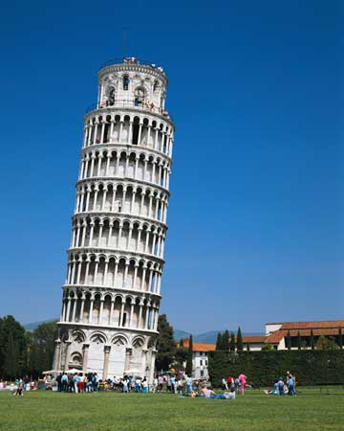
Weak footings lead to buildings that are heading towards disaster

Slide 6
Firm Footings allow buildings to reach unbievable heights

Slide 7
Why is the law of obedience so fundamental, so important?

Slide 8
How is faith important to keeping the law of obedience?
“And he gave unto them commandments, that they should worship the Lord their God, and should offer the firstlings of their flocks, for an offering unto the Lord.
An after many days an angel of the Lord appeared unto Adam, saying: Why dost thou offer sacrifices unto the Lord? And Adam said unto him: I know not, save the Lord commanded me.”
Moses 5: 5-6

Slide 9
How do the principles and activities of the Church map to the Laws
Laws
Principles & actions
Law of Obedience
Law of Sacrifice
Law of the Gospel
Law of Chastity
Law of Consecration
Faith
Repentance
All things we are asked to do
Purity & Happy Family Life
True Discipleship
Increased
Spirit

Slide 10
A House of God
True Discipleship
Roof
Law of
Consecration
Law of
Chastity
Purity & Happy
Family Life
Walls
Commandments
Law of the Gospel
Floor
Repentance
Law of Sacrifice
Foundation
Faith
Law of Obedience
Footings

Slide 11
“When obedience ceases to be an irritant and becomes our quest, in that moment God will endow us with power.” –President Ezra Taft Benson

Slide 12
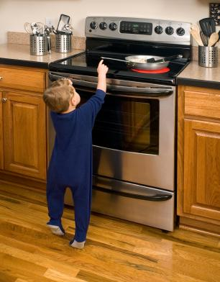
Why is God so mean in that He punishes us when we are disobedient to His commandments?
Is He really punishing us when we break a commandment?
Is a parent causing the pain of their child when they break the rules and touch a hot stove?

Slide 13
Why does God always want to restrict my freedom?

Slide 14
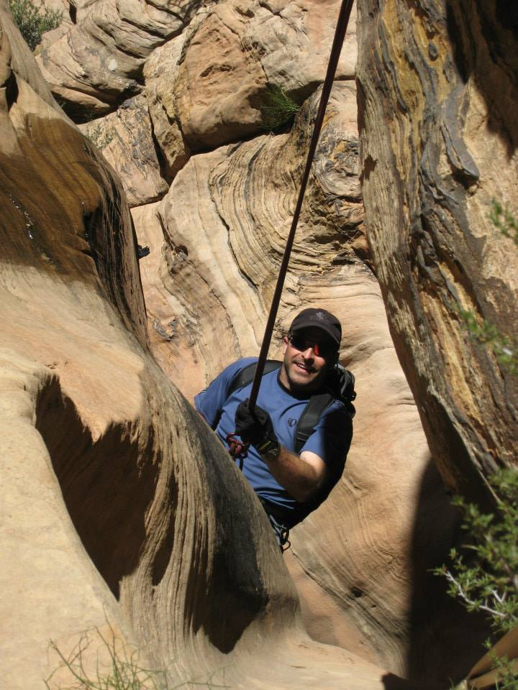
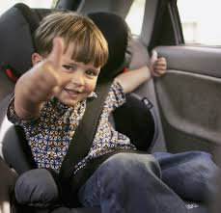
bnwolthuis@hotmail.com
What we sometimes view as restrictions and burdens actually give us the freedom to go places we never dreamed we would go.

Slide 15
“Obedience – that which God will never take by force – he will accept when freely given, and he will then return to you freedom that you can hardly dream of – the freedom to feel and to know, the freedom to do, and the freedom to be, at least a thousand fold more than we offer him. Strangely enough, the key to freedom is obedience.” –President Boyd K. Packer

Slide 16
“Behold, I say unto you, wickedness never was happiness.” -Alma 41:10
Why is everything God wants us to do boring? He never lets us do anything fun and enjoyable.
If we continue in His path, the atonement will change our hearts so that we see things as God sees them and find pleasure in the things He finds pleasure in (serving and loving others)

Slide 17
How does Lucifer gain power over us when we do not keep our covenants and break the commandments?

Slide 18
How does obedience to the commandments develop respect in the family and ward?
Obedience to God’s laws brings the Spirit. When the Spirit is present we can more easily love and be loved by others.
Obedience requires repentance. Repentance requires humility. Humility is an essential ingredient for harmony and mutual respect. God requires the sacrifice of a broken heart and a contrite spirit (3 Nephi 9:20).
Family and ward commitment to obedience increases the spirit of cooperation towards common goals, which in turn help minimize contention.

Slide 19
What can we do to gain the strength and self discipline to be obedient to a particular principle that we are struggling with?
Fasting and prayer
How does fasting help us become more disciplined?
Ask others to pray for us.
Ask for a blessing
Attend the Temple (if possible)
Doing things that are difficult (diet, exercise).
Discipline is like a muscle. If it is not used very often, it gets soft. Self discipline in other aspect of our lives can strengthen our ability to gain spiritual self discipline. The body and spirit are the soul of man. What you do to your body affects your spirit, and visa versa.

Slide 20
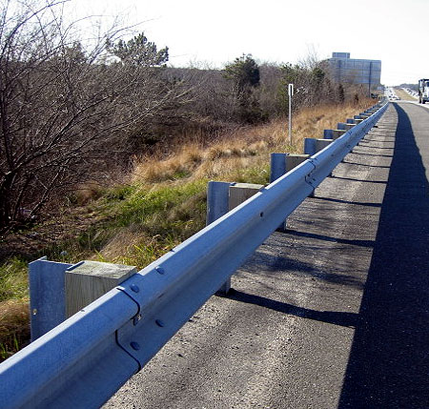
How can your environment effect your ability to be obedient?
By purposely choosing our environments, we can line our straight and narrow path with guard rails.
What experiences have you had where changing your environment has helped you be more obedient?

Slide 21
Have you ever had the thought: I’ve been obedient all of my life. Why is the Lord allowing this to happen to me?

Slide 22
Why does God allow challenges to still come into our lives even when we are striving to be obedient?
“… if fierce winds become thine enemy; if the heavens gather blackness, and all the elements combine to hedge up the way; and above all, if the very jaws of hell shall gape open the mouth wide after thee, know thou, my son, that all these things shall give thee experience, and shall be for thy good.”
-D&C 122:7

Slide 23
Have you ever known someone who has been able to have a terrible experience and have somehow found the strength to become a better person because of it?
Have you ever know someone who had a terrible experience and have become so bitter that they spiral into darkness and disfunction?

Slide 24
The Master Weaver has the power to weave even our darkest experiences in a beautiful tapestry of love and learning if we will but turn to Him
My life is but a weaving
Between my Lord and me;
I cannot choose the colors
He worketh steadily.
Ofttimes He weaveth sorrow
And I in foolish pride,
Forget that He seeth the upper,
And I the under side.
Not till the loom is silent
And the shuttles cease to fly,
Shall God unroll the canvas
And explain the reason why.
The dark threads are as needful
In the Weaver’s skillful hand,
As the threads of gold and silver
In the pattern He has planned.
-Elder Neal A Maxwell

Slide 25
If we are saved by grace (which we most definitely are) why does God still require us to strive for obedience?
We are learning heaven. If we are learning to be like our Heavenly Father, we must learn to be obedient, because He is obedient… as demonstrated by the life of His only begotten Son.
The Commandments are not for God’s amusement, they are for our success, improvement, and happiness.
God will not entrust us with greater power if we cannot demonstrate a capacity for obedience.
In fact, He probably cannot, any more than an Aeronautics University can bestow the power of flight on the creation of one of their graduate’s aircraft designs if the graduate does not obey the laws of Aerodynamics.

Slide 26
Behold, to obey is better than sacrifice -1 Samuel 15:22
Why should obedience always come before sacrifice in priority?
What can be the consequences of sacrifice first and obedience second?
Pre-payment through sacrifice/penance for pre-meditated disobedience.
Missionaries being disobedient during High School and planning on repenting/sacrificing later to serve a mission (prior to raising the bar).
Priorities out of balance –spending too much time on your calling and not enough time with your family in opposition to what the Prophets counsel. What good does it do to save the whole ward, if you lose your family in the process?

Slide 27
The proper order is to sacrifice in order to be obedient
When done in that order we are endowed with power.
What examples have you had in your life where you have been blessed by sacrificing to be obedient to a principle of the gospel.
The families of early Saints were blessed with incredible faith when the husbands/fathers were obedient to the calling to serve missions.
The early Saints were asked to make incredible sacrifices to build temples (Kirtland, Nauvoo) and they were blessed with the Endowment, Temple Sealings, and redemption for the dead.
Early Saints made huge sacrifices to be obedient to the call to gather to Utah. They and their descendants have been eternally blessed by their obedience.
Youth who have sacrificed two years to be obedient to the call to serve missions have generally been blessed with stronger testimonies, greater confidence and work ethic, more successful marriages and families, and greater public speaking and foreign language skills.
Examples

