Slide 1
Chastity: Of Souls, Symbols, and Sacraments
Bishop’s Youth Fireside
Some say the world will end in fire,
Some say in ice.
From what I’ve tasted of desire
I hold with those who favor fire.
-Robert Frost
Based on a 1988 BYU Devotional by Jeffery R. Holland,
then president of BYU (additions/modifications in red)

Slide 2
Fireside Goals
Explain why keeping the Law of Chastity is so important to your current and future happiness.
Explain that no matter what mistakes have been made, we can always be forgiven and healed through Christ’s infinite atonement.

Slide 3
Why talk about Chastity?
“A philosopher once said, tell me sufficiently why a thing should be done, and I will move heaven and earth to do it.”

Slide 4
Why so serious?
“The prophet Alma warns his son Corianton that sexual transgression is ‘an abomination in the sight of the Lord; yea, most abominable above all sins save it be the shedding of innocent blood or denying the Holy Ghost’ “
“Clearly God's greatest concerns regarding mortality are how one gets into this world and how one gets out of it. These two most important issues in our very personal and carefully supervised progress are the two issues that he as our Creator and Father and Guide wishes most to reserve to himself.”
“These are the two matters that he has repeatedly told us he wants us never to take illegally, unfaithfully, without sanction.”

Slide 5
Taking Life
“As for the taking of life, we are generally quite responsible. Most people, it seems to me, readily sense the sanctity of life and as a rule do not run up to friends, put a loaded revolver to their heads, and [thoughtlessly] pull the trigger. Furthermore, when there is a click of the hammer rather than an explosion of lead, and a possible tragedy seems to have been [avoided], no one in such a circumstance would be so stupid as to sigh, ‘Oh, good. I didn't go all the way.’ “
“No, fortunately, in the case of how life is taken, I think we seem to be quite responsible. The seriousness of that does not often have to be spelled out, and not many sermons need to be devoted to it.”

Slide 6
Giving Life
“But in the significance and sanctity of giving life, some of us are not so responsible, and in the larger world swirling around us we find near criminal irresponsibility.“
“What would in the case of taking life bring absolute horror and demand grim justice, in the case of giving life brings dirty jokes and four-letter lyrics and [thoughtless sexuality] on the [movie] screen, home-owned or downtown.”

Slide 7
Of Souls
“One of the ‘plain and precious’ truths restored to this dispensation is that ‘the spirit and the body are the soul of man’ (D&C88:15; emphasis added) and that when the spirit and body are separated, men and women ‘cannot receive a fulness of joy’ (D&C93:34).”
“It is peculiar to the theology of the Latter-day Saints that we regard the body as an essential part of the soul.”
“So partly in answer to why such seriousness, we answer that one toying with the God-given body of another, toys with the very soul of that individual.”

Slide 8
Trivializing the Soul of Another
“In [making light of] the soul of another (please include the word body there), we [make light of] the Atonement that saved that soul and guaranteed its continued existence. And when one toys with the Son of Righteousness…, one toys with white heat and a flame hotter and holier than the noonday sun. You cannot do so and not be burned.”
But what if a pregnancy does not occur?
Is it so bad in that case?
What if the two people love each other?
Isn’t that reason enough?
What if we plan on getting married?
Notes:
The answers to these questions are given in the following slides, but the basic answer is that our happiness in marriage depends on how well we honor the law of chastity.

Slide 9
Of Symbols
“…may I suggest that human intimacy, that sacred, physical union ordained of God for a married couple, deals with a symbol that demands special sanctity. Such an act of love between a man and a woman is--or certainly was ordained to be--a symbol of total union: union of their hearts, their hopes, their lives, their love, their family, their future, their everything.”

Slide 10
Moral Schizophrenia
Schizophrenia: a mental disorder where the person has a hard time distinguishing fantasy from reality. In this context, moral schizophrenia could be thought of as the loss of ability to distinguish good from evil, or of distinguishing love from lust.
“Can you see then the moral schizophrenia that comes from pretending we are one, sharing the physical symbols and physical intimacy of our union, but then fleeing, retreating, [cutting off] all such other aspects--and symbols--of what was meant to be a total obligation, only to unite again [shamefully] some other night or, worse yet, [shamefully] unite with some other partner who is no more bound to us, no more one with us than the last was…?”

Slide 11
Russian Roulette
“ You must wait--you must wait until you can give everything, and you cannot give everything until you are at least legally and, for Latter-day Saint purposes, eternally pronounced as one. …to give only part of that which cannot be followed with the gift of your whole heart and your whole life and your whole self is its own form of emotional Russian roulette.”
“If you persist in sharing part without the whole, in pursuing satisfaction devoid of symbolism, in giving parts and pieces, you run the terrible risk of such spiritual, [psychological] damage that you may [weaken or damage] both your physical intimacy and your wholehearted devotion to a truer, later love.”
Notes:
Russian Roulette is a twisted game that insane people play where they put one bullet in a six chamber revolver, spin the chamber, put the gun to their head, and then pull the trigger. They have a 1 in 6 chance that they will blow their brains out.

Slide 12
You May Discover to your Horror
“You may come to that moment of real love, of total union, only to discover to your horror that what you should have saved has been spent, and--mark my words--only God's grace can recover that piecemeal dissipation of your virtue.”

Slide 13
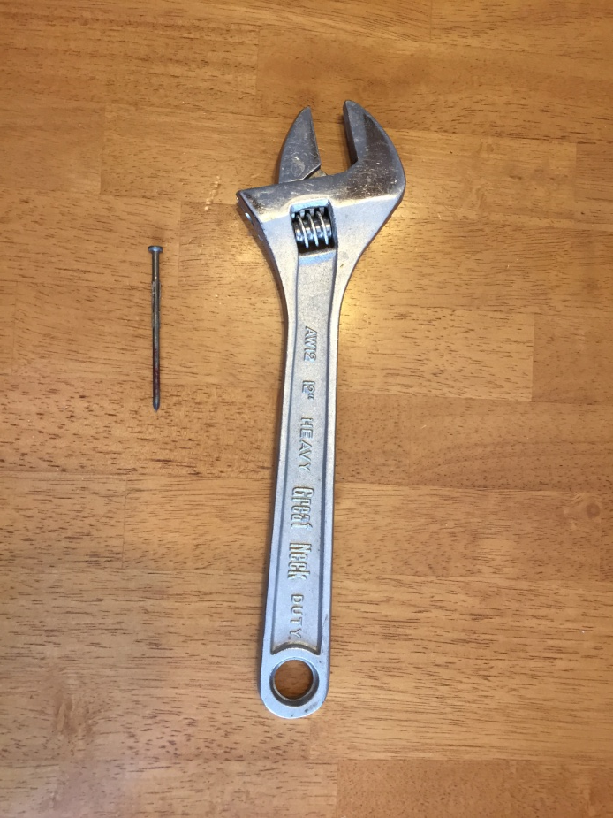
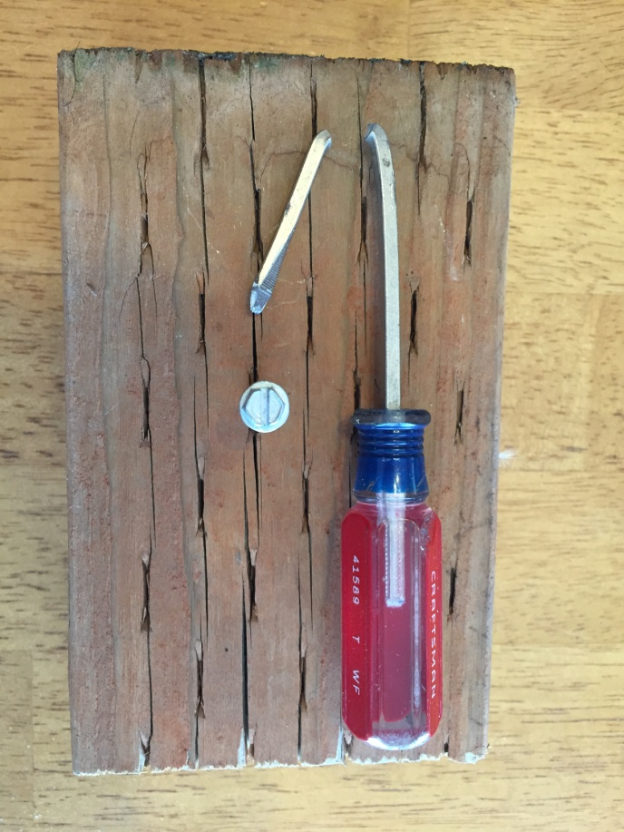
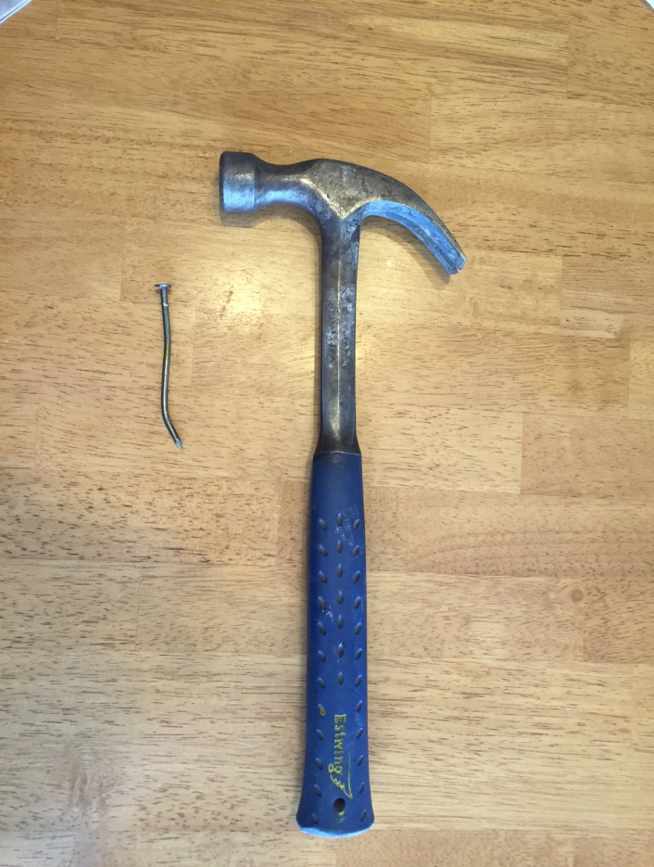
Tool Analogy
Human intimacy is a sacred tool that God has given to us to help us experience true joy in marriage. But any tool, if used in the wrong way, can be damaged to the point that it no longer functions in the way intended(see notes at bottom).
Notes:
Using the sacred gift of human sexuality in any other way than in bonding a husband and wife together, and/or creating a new life within those bonds of marriage will damage the tool until it will no longer functions as a tool to bring husbands and wives together emotionally and spiritually. Instead, it will be purely carnal, self centered, self gratifying –in other words– devilish. Like anything, a tool can be mended, and in this case it can be fully mended by Christ’s atonement. But the more severe the damage, the longer it will take to repair. In severe cases like adultery or multiple partners, although the person may become worthy to participate in Church ordinances within a years time after sincere repentance, it may take years and years and years to heal the psychological damage and wrong thinking that has been created.

Slide 14
Don’t be deceived
“Don't be deceived and don't be destroyed. Unless such fire is controlled, your clothes and your future will be burned. And your world, short of painful and perfect repentance, will go up in flames.”
“I give that to you on good word—
I give it to you on God's word.”

Slide 15
Of Sacraments
“…a sacrament could be any one of a number of gestures or acts or ordinances that unite us with God and his limitless powers. We are imperfect and mortal; he is perfect and immortal. But from time to time--indeed, as often as is possible and appropriate--we find ways and go to places and create circumstances where we can unite symbolically with him, and in so doing gain access to his power. Those special moments of union with God are sacramental moments--such as kneeling at a marriage altar, or blessing a newborn baby, or partaking of the emblems of the Lord's supper.”
“These are moments when we quite literally unite our will with God's will, our spirit with his spirit, where communion through the veil becomes very real. At such moments we not only acknowledge his divinity, but we quite literally take something of that divinity to ourselves. Such are the holy sacraments.”

Slide 16
Sexual Union: a Very Real Sacrament
“…sexual union is also, in its own profound way, a very real sacrament of the highest order, a union not only of a man and a woman but very much the union of that man and woman with God.”

Slide 17
Earth Shattering Power
“I know of nothing so earth-shatteringly powerful and yet so universally and [freely] given to us as the God-given power available in every one of us from our early teen years on to create a human body, that wonder of all wonders, a genetically and spiritually unique being never seen before in the history of the world and never to be duplicated again in all the ages of eternity--a child, your child-- with eyes and ears and fingers and toes and a future of unspeakable grandeur.”
“I submit to you that no power, priesthood or otherwise, is given by God so universally to so many with virtually no control over its use except self-control. And I submit to you that you will never be more like God at any other time in this life than when you are expressing that particular power.”

Slide 18
Father, Mother
“Of all the titles he has chosen for himself, Father is the one he declares, and Creation is his watchword--especially human creation, creation in his image. His glory isn't a mountain, as stunning as mountains are. It isn't in sea or sky or snow or sunrise, as beautiful as they all are. No, his glory--and his grief--is in his children.”
“Human life--that is the greatest of God's powers, the most mysterious and magnificent chemistry of it all--and you and I have been given it, but under the most serious and sacred of restrictions. You and I who can make neither mountain nor moonlight, not one raindrop nor a single rose--yet we have this greater gift in an absolutely unlimited way. And the only control placed on us is self-control--self-control born of respect for the divine sacramental power it is.”
“Surely God's trust in us to respect this future-forming gift is awesomely staggering.”

Slide 19
Souls. Symbols. Sacraments.
“Does any of this help you understand why human intimacy is such a serious matter? Why it is so right and rewarding and stunningly beautiful when it is within marriage and approved of God (not just "good" but "very good," he declared to Adam and Eve), and so blasphemously wrong--like unto murder--when it is outside such a covenant?”

Slide 20
Bishop’s Comment Slides

Slide 21
Lucifer’s Loopholes –aka Lucifer’s lies
“A lot or Mormon’s my age don’t consider oral sex to be sex” so it is OK –False!
I will solve this problem on my own, then go to see the Bishop –False!
That is like waiting to go to the doctor after you are no longer sick.
Since I stopped the problem on my own, I don’t need to talk to the bishop –False!
Any violations of the law of chastity needs to be confessed to the Bishop.
The Law of Chastity is: no sexual relations with anyone other than our spouse (after we have been married to them).
So sexual relations with other people, magazine, movies, videos, or ourselves(masturbation), violates the law of chastity.
That includes intentionally touching the personal private parts of another persons body with or without clothing

Slide 22
Victims of Sexual abuse
Anyone sexually abused against their will is not guilty of violating the law of chastity.
Children sexually abused by older children or adults are not guilty of violating the law of chastity.
Christ’s atonement is especially important in helping victims fully heal and forgive.
Although victims are not guilty of sin, they may need counseling to heal the psychological damage.

Slide 23
Conclusion: God’s Grace
What do I do if I have made a mistake?
Please, Please, Please come talk to the Bishop.
Remember that God’s Grace can make up for any mistake.
His atonement can make whole that which is bent or broken.
It may not be easy and it may not be all at once, but His healing miracle is sure.

